Slide 1
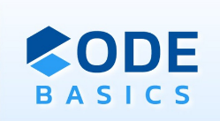


Code Besics Resume challenge AtliQ Motors Analysis
Shweta Vishwakarma Data Analyst

Slide 2


About AtliQ Motors
Goal
Charts
More Reasults
Secondary Q & A
Agenda
Recomondation for AtliQ Motors
Thank You

Slide 3
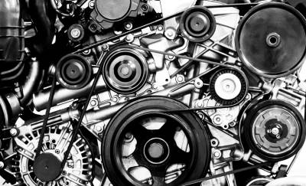
About AtliQ Motors
AtliQ Motors is an automotive giant from the USA specializing in electric vehicles (EV).
In the last 5 years, their market share rose to 25% in electric and hybrid vehicles segment in North America.

Slide 4
Goal
As a part of AtliQ Motors expansion plans, they wanted to launch their bestselling models in India where their market share is less than 2%.
The chief of AtliQ Motors India wanted to do a detailed market study of existing EV/Hybrid market in India before proceeding further.

Slide 5
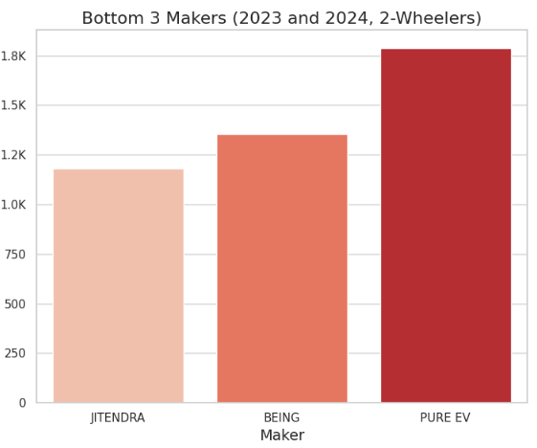
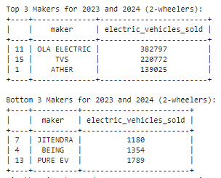
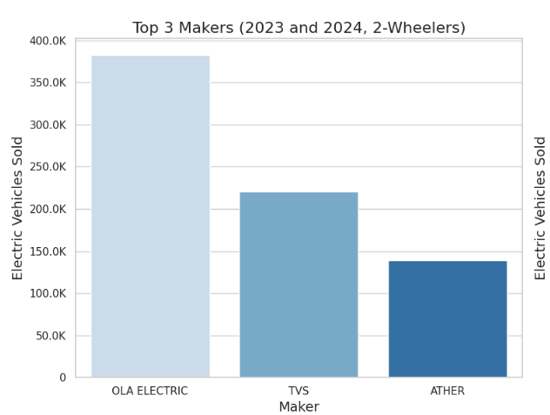
1)Top 3 & bottom 3 makers for the fiscal years 2023 and 2024 for 2-wheelers sold.

Slide 6
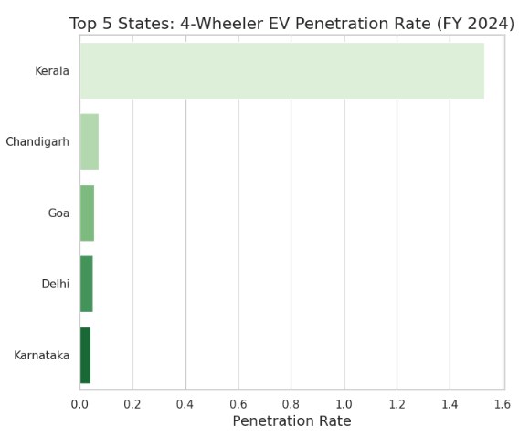
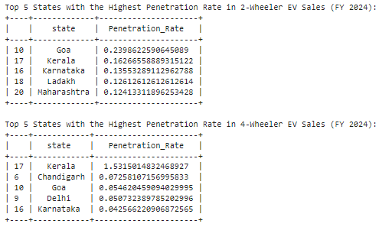
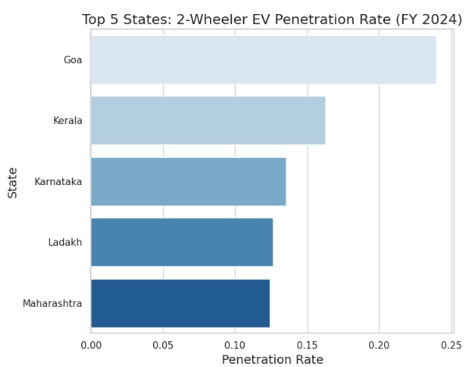
2) Identify the top 5 states with the highest penetration rate in 2-wheeler & 4-wheeler EV sales in FY 2024

Slide 7
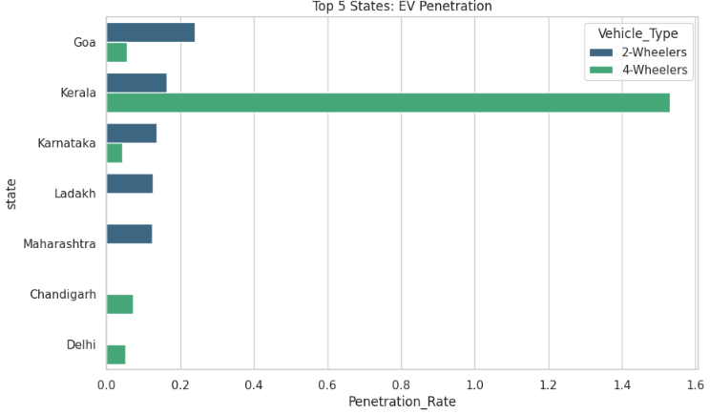
Identify the top 5 states with the highest penetration rate in 2-wheeler & 4-wheeler EV sales in FY 2024

Slide 8
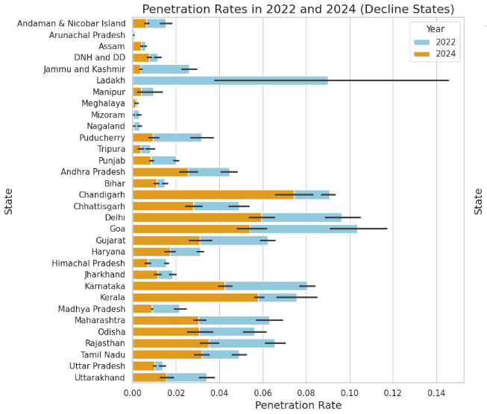
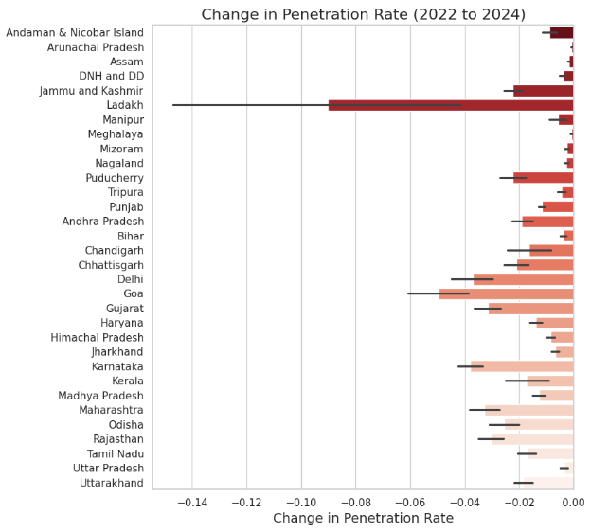
3) States with negative penetration (decline) in EV sales from 2022 to 2024

Slide 9
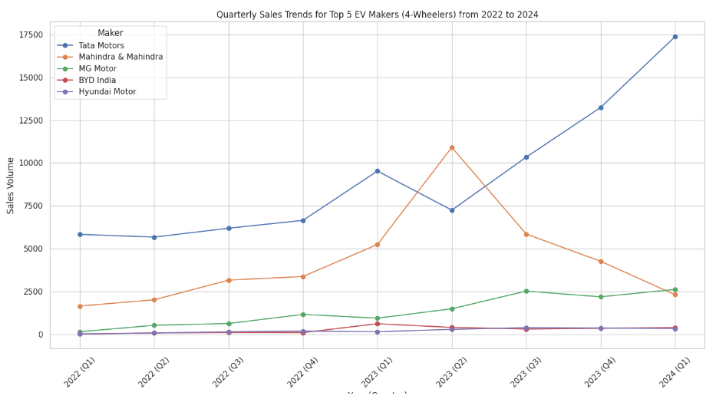
4) Finding quarterly trends based on sales volume for the top 5 EV makers (4-wheelers) from 2022 to 2024

Slide 10

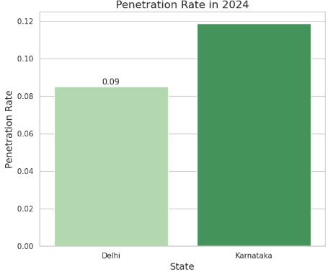
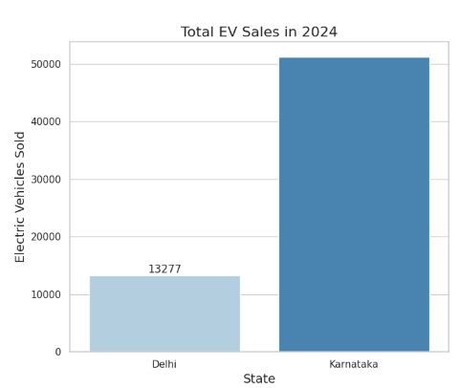
5) EV sales and penetration rates in Delhi compare to Karnataka for 2024?

Slide 11
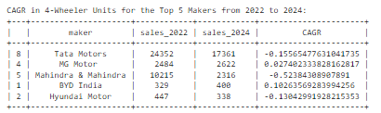
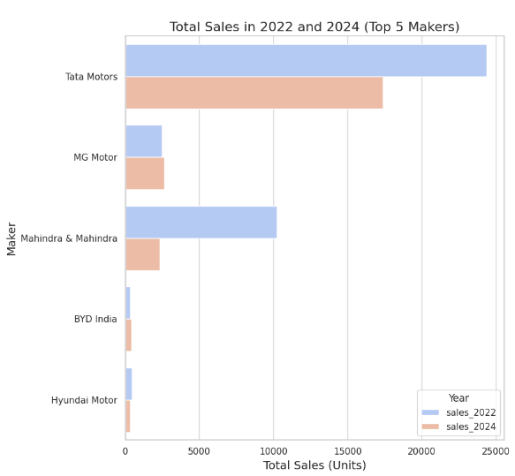
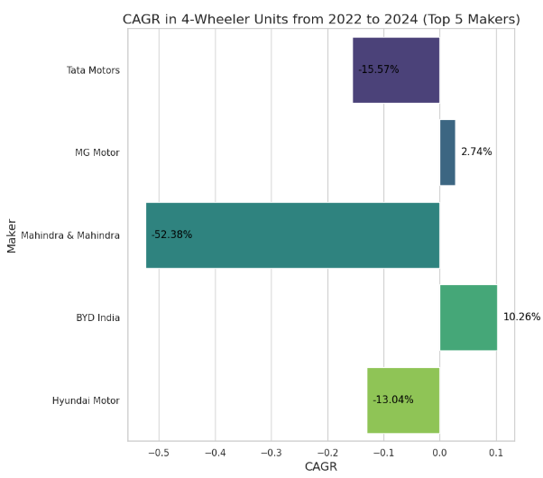
6) CAGR in 4-wheeler units for top 5 makers from 2022 to 2024.

Slide 12
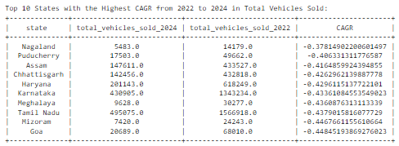
7) Top 10 states that had Highest CAGR from 2022 to 2024 in total vehicles sold.

Slide 13
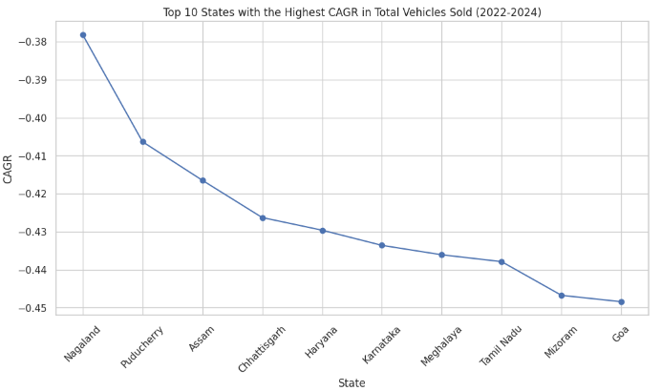
Top 10 states that had Highest CAGR from 2022 to 2024 in total vehicles sold.

Slide 14

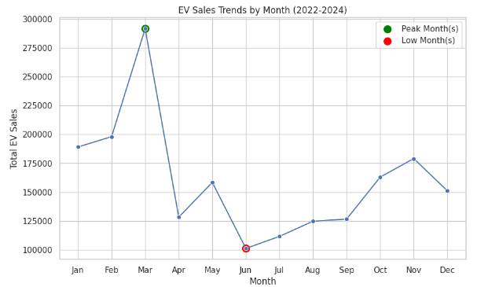

Peak and low season months for EV sales from
2022 to 2024

Slide 15
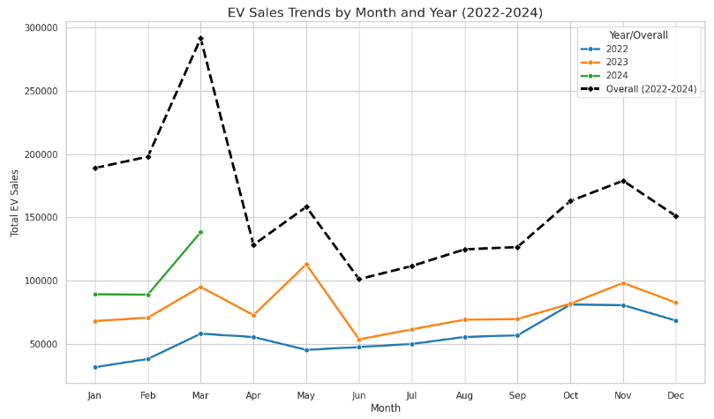
Peak and low season months for EV sales based on the data from 2022 to 2024

Slide 16
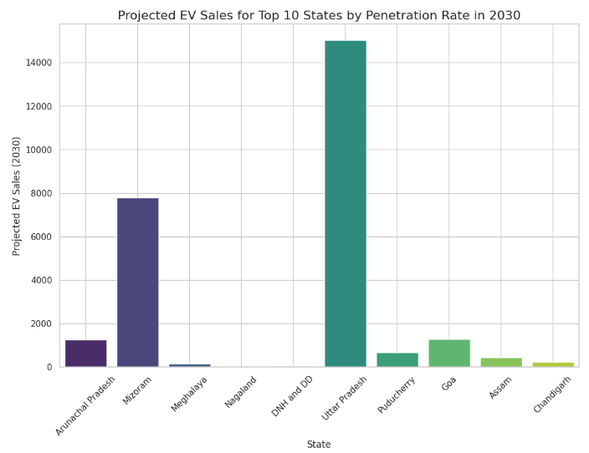
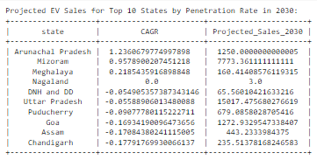
8) Projected EV Sales For Top 10 States by Penetration Rate in 2030

Slide 17
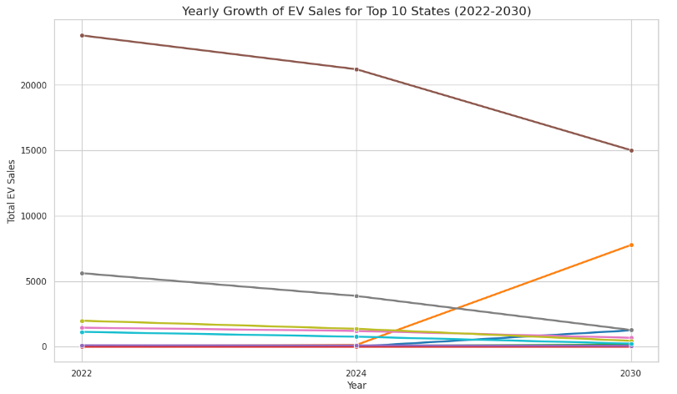
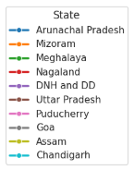
Projected EV Sales For Top 10 States by Penetration Rate in 2030

Slide 18
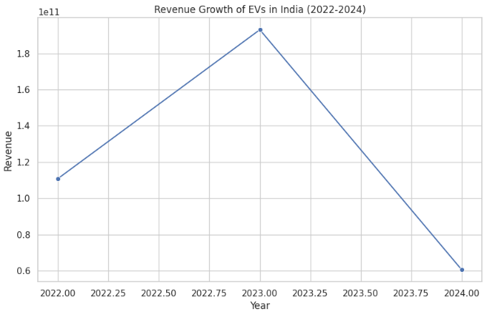

10) Revenue growth rate of 4-wheeler and 2-wheelers EVs in India for 2022 vs 2024 & 2023 vs 2024
Average unit price.
2-Wheelers -> 85,000.00
4-Wheelers -> 15,00,000.00

Slide 19

More Reasults

Slide 20
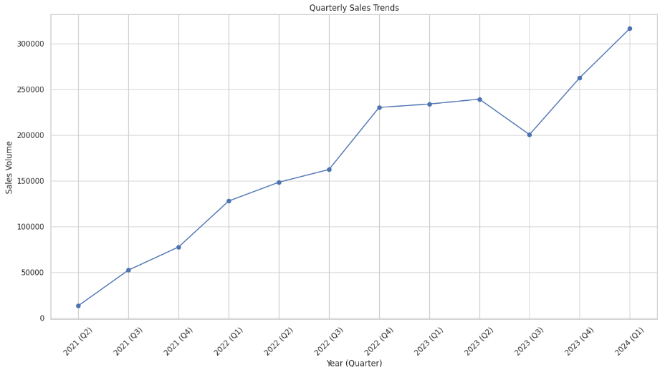
Quarterly Sales Trend Over Time

Slide 21
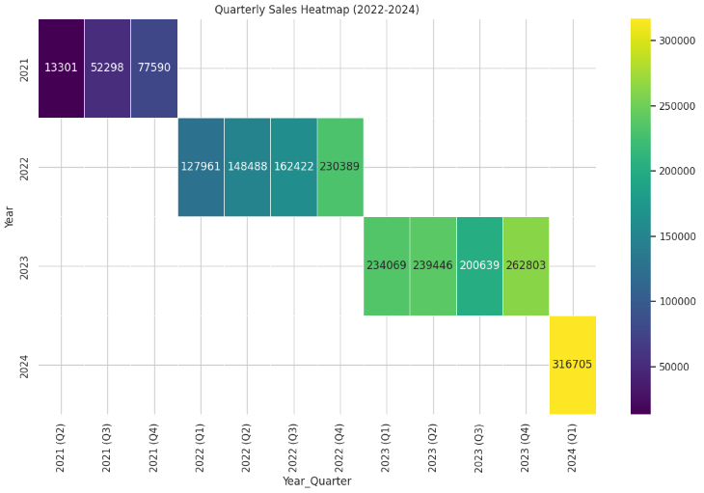
Quarterly Sales Trend Over Time

Slide 22
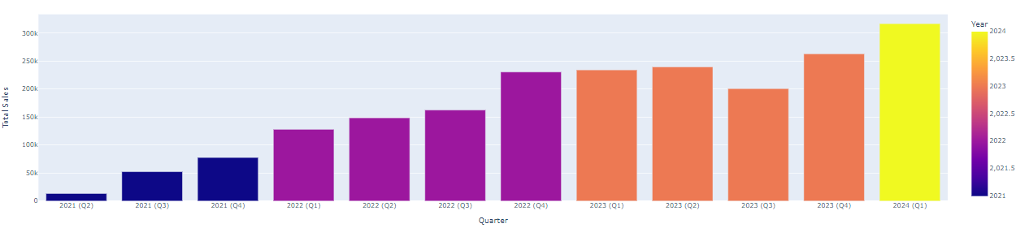
Total Quarterly E .V. Sales

Slide 23
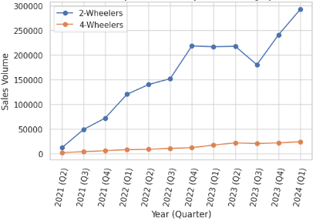
Quarterly Sales Trend by Vehicle Category

Slide 24
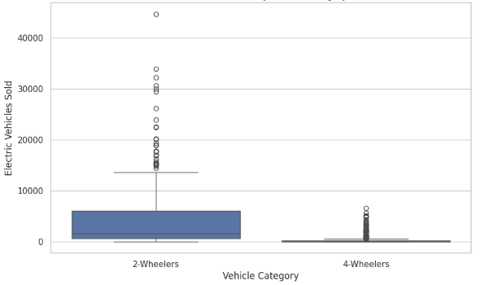
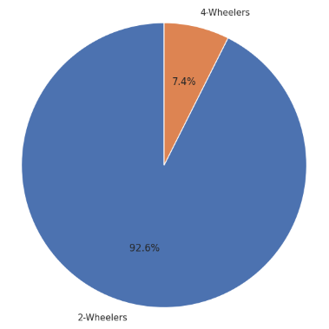
Sales Distribution By Vehicle Category

Slide 25
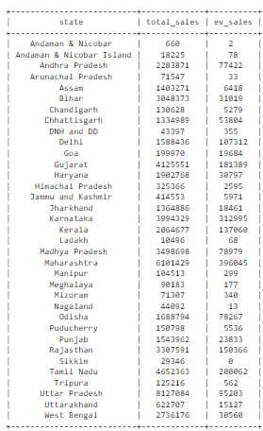
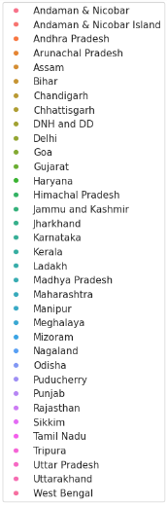
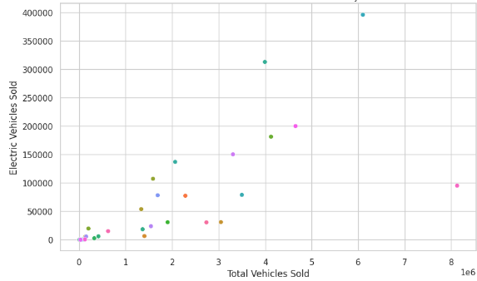
Total Sales By E.V. Sales BY State

Slide 26
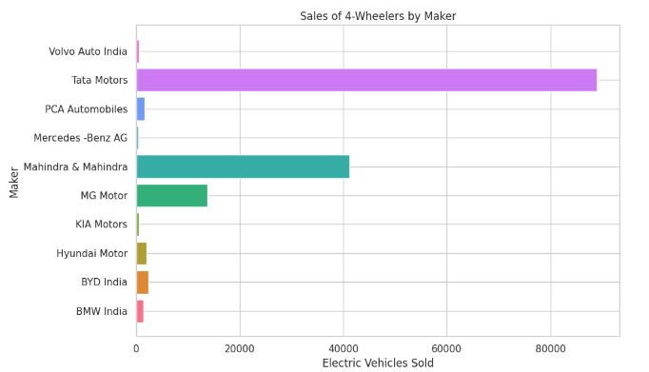
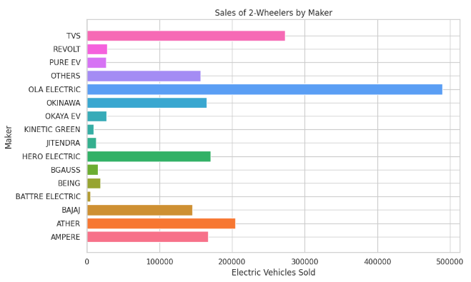
Sales By Makers

Slide 28

Secondary Questions & Answers

Slide 29
1. Primary reasons for customers choosing 4-wheeler EVs in 2023 and 2024
Cost Savings:
Fuel Saving
Maintenance cost
Total Cost of Ownership
Environment Concern
Reduce Emissions
Increased Awareness
Low Emission Zone
Government Incentive
Tax Credit
Regulations & Mandate
Government Policy & Incentives
Economic factors:
Falling Prices
Resale value
Other Factors:
Infrastructure Development
Technology Advancement
Increase Adoption & Market growth

Slide 30
2.Ideal State of India to start the manufacturing unit
(Based on subsidies provided, ease of doing business, stability in governance )
For a manufacturing unit in India
Gujarat
Maharashtra
Tamil Nadu,
Karnataka
Andhra Pradesh
Key factors to consider:
Subsidies and incentives
Ease of doing business
Infrastructure
Labor market
Political stability

Slide 31
Higher Sales: States like Delhi and Maharashtra with dense networks see more EV sales.
Boosted Penetration: Better infrastructure in urban areas drives higher EV adoption.
Wider Adoption: Tamil Nadu’s highway stations support broader EV use.
Faster Growth: Incentives in Gujarat and Karnataka accelerate both EV sales and infrastructure growth.
3)Availability of charging stations infrastructure correlation with the EV sales and penetration rates in the top 5 states

Slide 32
Ratan Tata: A respected leader in business and sustainability, Ratan Tata's endorsement would add credibility and align with AtliQ Motors' focus on innovation and environmental responsibility.
Shah Rukh Khan: His vast fan base and modern, charismatic image can effectively promote AtliQ Motors as a stylish and desirable choice across diverse demographics.
4)Who should be the brand ambassador if AtliQ Motors launches their EV/Hybrid vehicles in India and why?"

Slide 33
Aamir Khan: His socially conscious image and influence can position AtliQ Motors as an environmentally responsible brand, boosting awareness and adoption of EVs.
Priyanka Chopra Jonas: Her global appeal and strong presence in India can help AtliQ Motors connect with both domestic and international audiences, aligning with the brand's innovation and sustainability themes.
4)Who should be the brand ambassador if AtliQ Motors launches their EV/Hybrid vehicles in India and why?"

Slide 34
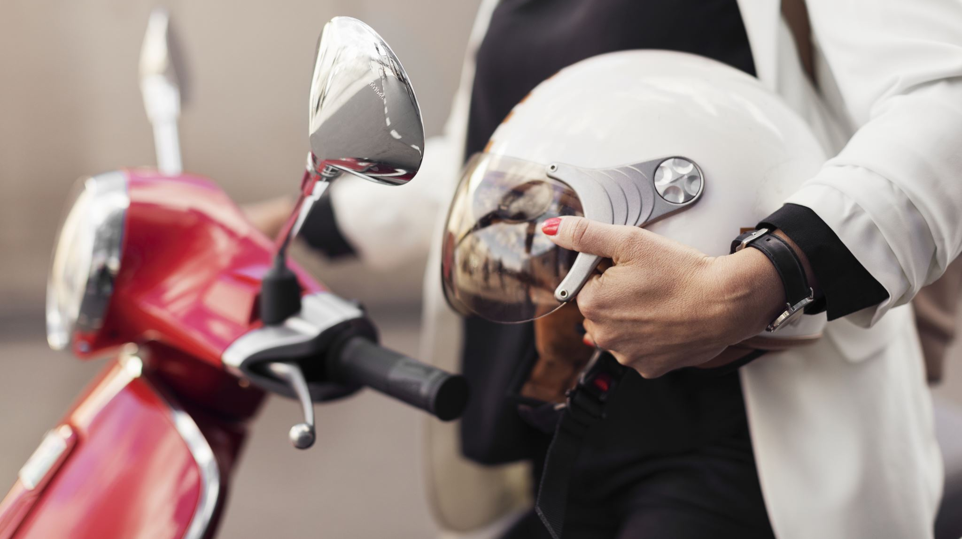
5) Impact of Adoption Rate by Government For 2-wheelers and 4-wheelers And States with most subsidies in India
Impact:
2-Wheelers: Subsidies make EV 2-wheelers more affordable, boosting adoption in price-sensitive, urban markets.
4-Wheelers: Higher subsidies help bridge the price gap with traditional vehicles, encouraging broader adoption.
Leading States:
Delhi, Gujarat, Maharashtra, and Karnataka offer the most significant subsidies, driving higher EV adoption in these regions.
AtliQ Motors:
Focusing on states with strong incentives will enhance the adoption of AtliQ Motors' EVs, particularly in these high-subsidy markets.

Slide 35

Recommendations for AtliQ Motors

Slide 36
1..Partnerships for Raw Materials:
Secure partnerships with suppliers of raw materials, such as lithium or cobalt, essential for battery production. This guarantees a stable supply and helps in negotiating better prices.
2..Green Logistics:
Use environmentally friendly logistics solutions, such as electric or hybrid trucks for transportation, and optimize routes to reduce emissions and fuel costs.
3...Investment in Technology
Blockchain for Transparency: Implement blockchain technology to enhance transparency and traceability across the supply chain. This can improve trust with customers and partners by providing real-time data on product origins and movements
Automation and Robotics: Invest in automation and robotics for manufacturing and warehousing operations. This can significantly reduce labor costs, increase precision, and speed up production times.

Slide 37
Thank You

